Slide 1
House Prices: Advanced Regression Techniques
組員：
統計四 陳庭偉
統碩一 陳柏勳
統碩一 楊博安
統碩一 林威均
資管碩二 周平

Slide 2
Contents
Data Information
Data Preprocessing
EDA
Modeling
(1) Random Forest
(2) XGBoost
(3) Support Vector Regression
5. Reference

Slide 3
Data Information

Slide 4
What is our goal?
Data Description and Our Goal : Ask a home buyer to describe their dream house, and they probably won't begin with the height of the basement ceiling or the proximity to an east-west railroad. But this playground competition's dataset proves that much more influences price negotiations than the number of bedrooms or a white-picket fence.
With 79 explanatory variables describing (almost) every aspect of residential homes in Ames, Iowa, this competition challenges us to predict the final price of each home.
We assume that we are a bank, so we predict the final price of each home because of investment.

Slide 5
Data Information
The data is divided into the train and test, the train dataset has 1460, the test dataset has 1459
Train dataset:
id | MSSubClass | MSZoning | LotFrontage | . . . . . . . . . . . . . | SaleCondition | SalePrice
1 | 60 | RL | 65 | . . . . . . . . . . . . . . | Normal | 208500
2 | 20 | RL | 80 | . . . . . . . . . . . . . . | Normal | 181500
. . . | . . . | . . . | . . . | . . . | . . . | . . .
1459 | 20 | RL | 68 | . . . . . . . . . . . . . . | Normal | 142125
1460 | 20 | RL | 75 | . . . . . . . . . . . . . . | Normal | 147500

Slide 6
Data Information
Test dataset:
id | MSSubClass | MSZoning | LotFrontage | . . . . . . . . . . . . . . . . . | SaleCondition
1461 | 20 | RH | 80 | . . . . . . . . . . . . . . . . . | Normal
1462 | 20 | RL | 81 | . . . . . . . . . . . . . . . . . | Normal
. . . . . | . . . . . | . . . . . | . . . . . | . . . . . | . . . . .
2918 | 85 | RL | 62 | . . . . . . . . . . . . . . . . . | MnPrv
2919 | 60 | RL | 74 | . . . . . . . . . . . . . . . . . | NA

Slide 7
Data Information
Attribute Information: Due to the large number of variables, write the details into the PDF.

Slide 8
Data Preprocessing

Slide 9
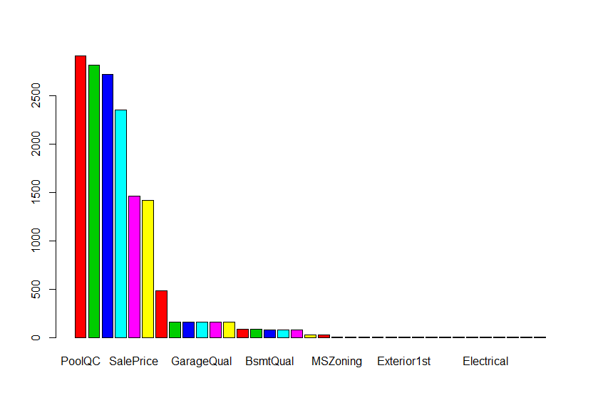
Data Preprocessing
首先把訓練集(train dataset)跟測試集(test dataset)合併，所以前1460筆是訓練集的資料，後面的則是測試集。
圖為各項變數的NA數量:
Notes:
接者，我們觀察各項變數的NA數量。

Slide 10
Data Preprocessing: Missing Value
根據變數狀況，我們做了：
變數名稱 | 狀況 | 處理方法
PoolQC, MiscFeature, Alley, Fence, FireplaceQu | 缺失值過多 | 刪除
Utilities | 幾乎是同一個值(AllPub) | 刪除
GarageType,GarageQual,GarageCond,GarageFinish,BsmtExposure,BsmtFinType2,BsmtQual,BsmtCond,BsmtFinType1 | 沒有這項設施 | 修改成None。
此外，針對變數缺失沒有這麼嚴重的變數，我們採用了KNN的方式進行插補。

Slide 11
Data Preprocessing : Order Variable
針對次序(order)變數，我們做了：
變數名稱 | 資料變更
LotShape | IR3=0,IR2=1,IR1=2,Reg=3
LandContour | Low=0,HLS=1,Bnk=2,Lvl=3
LandSlope | Sev=0,Mod=1,Gtl=2
ExterQual,ExterCond,BsmtQual,BsmtCond,HeatingQC,KitchenQual,GarageQual,GarageCond | None=0,Po=1,Fa=2,TA=3,Gd=4,Ex=5
BsmtExposure | None=0,No=1,Mn=2,Av=3,Gd=4
變數名稱 | 資料變更
BsmtFinType1, BsmtFinType2 | None=0,Unf=1,LwQ=2,Rec=3,BLQ=4,ALQ=5,GLQ=6
CentralAir | N=0,Y=1
Functional | Sal=0,Sev=1,Maj2=2,Maj1=3,Mod=4,Min2=5,Min1=6,Typ=7
GarageFinish | None=0,Unf=1,RFn=2,Fin=3
PavedDrive | N=0,P=1,Y=2

Slide 12
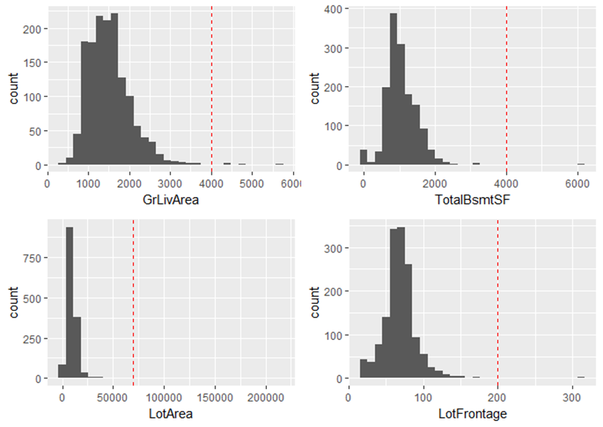
Data Preprocessing :Handling Outlier

Slide 13
EDA

Slide 14
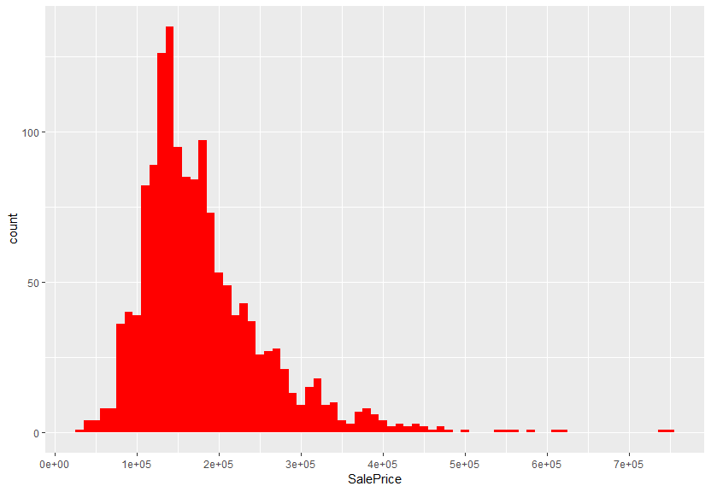
EDA
接下來看一下SalePrice的分佈，還有一些變數跟SalePrice的箱型圖:

Slide 15
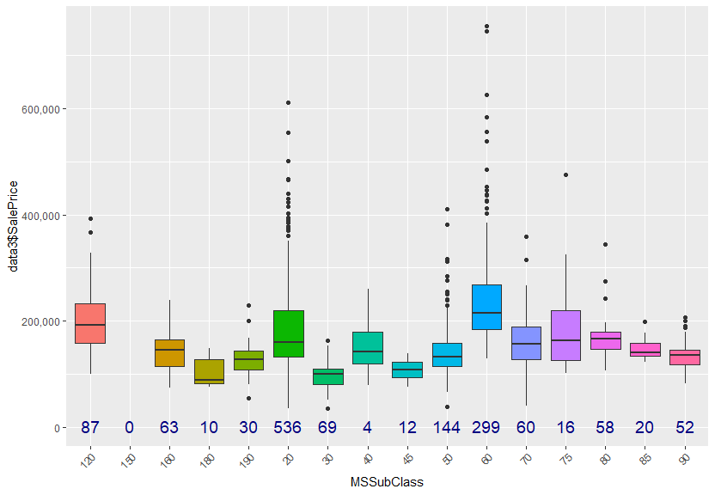
EDA

Slide 16
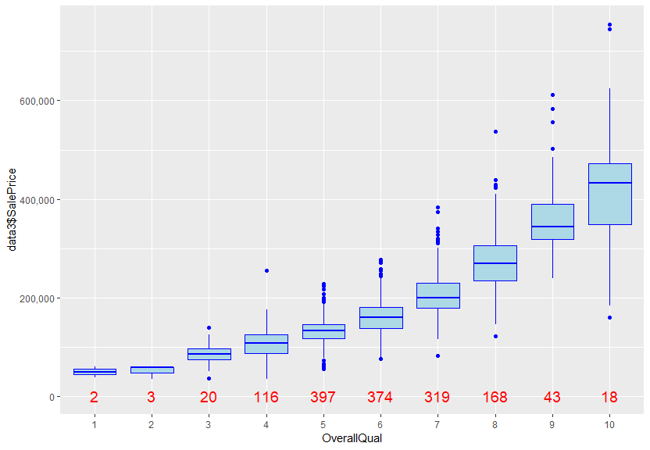
EDA

Slide 17
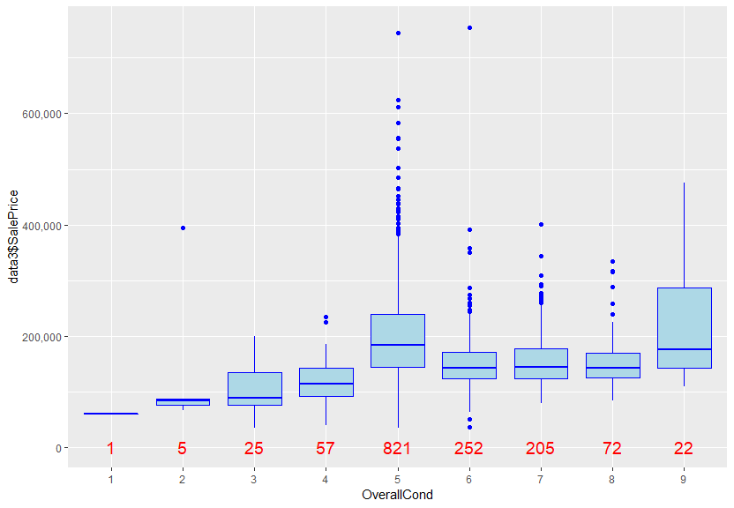
EDA

Slide 18
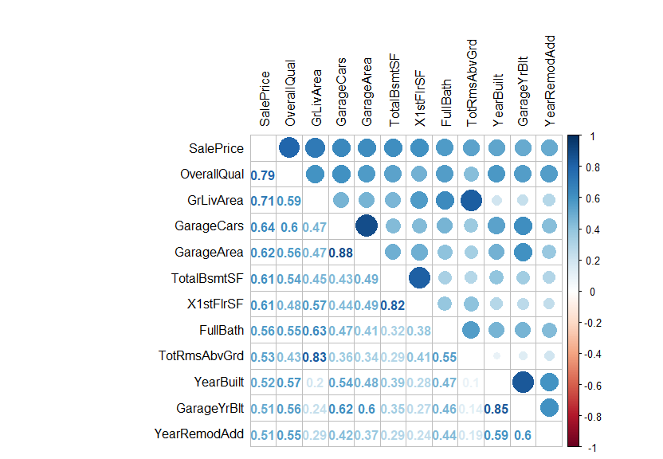
EDA
再來我們看一下相關係數大於0.5的相關矩陣，我們把它可視化。

Slide 19
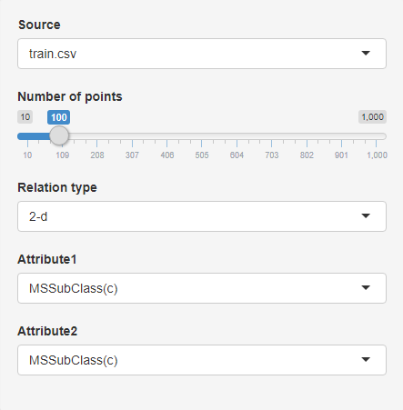
Visualization with Shiny
Control Panel Setting:
Source: specify data source(train/test)
Sample Point: specify sample point to display
Relation Type: specify distribution type(1d/2d)
Attribute1: specify first feature to display
Attribute2: specify second feature(if needed)

Slide 20
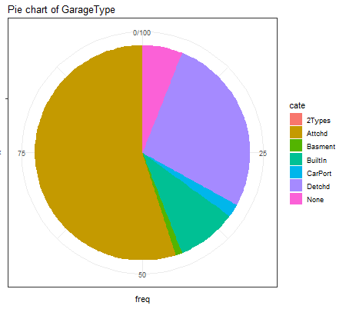
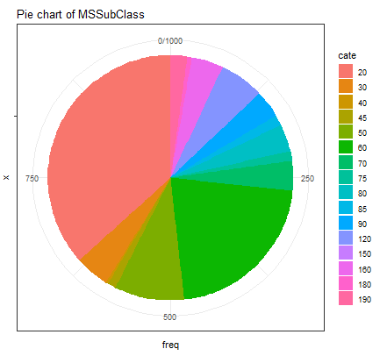
Visualization with Shiny
Visualize Variable Distribution with Different Sample Number

Slide 21
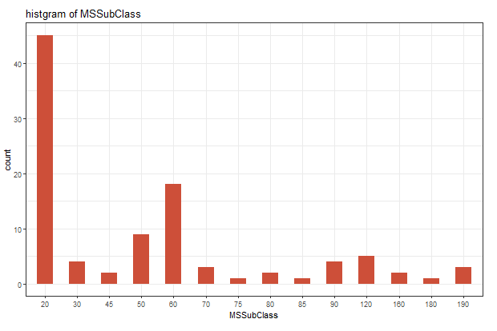
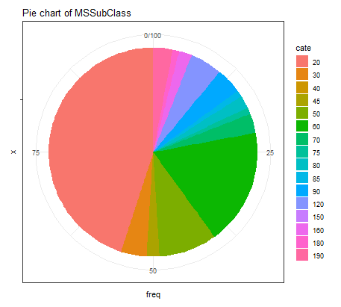
Visualization with Shiny
1 Dimensional Category Variable Distribution Graph:

Slide 22
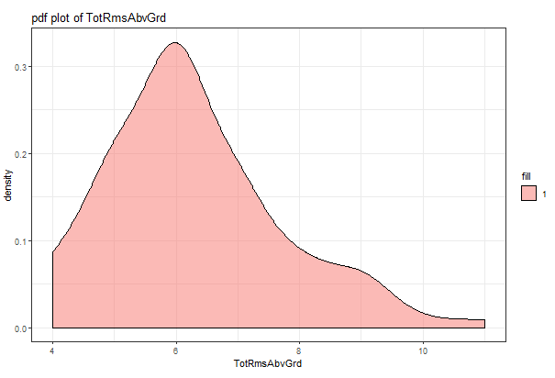
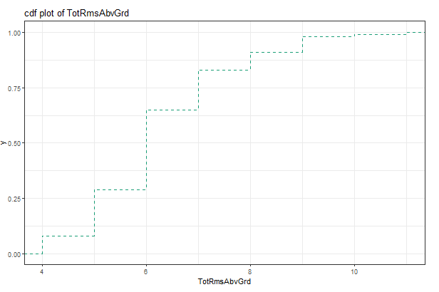
Visualization with Shiny
1 Dimensional Real Number Variable Distribution Graph:

Slide 23
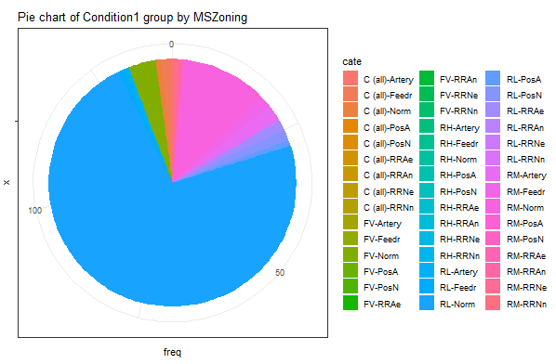
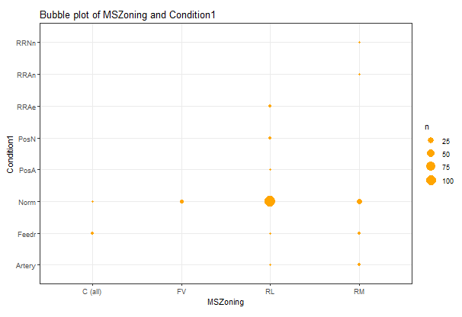
Visualization with Shiny
2 Dimensional Distribution Graph with 2 Category Variable:

Slide 24
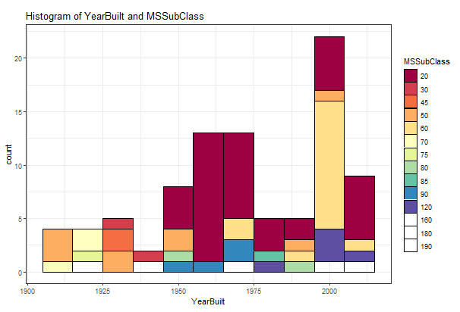
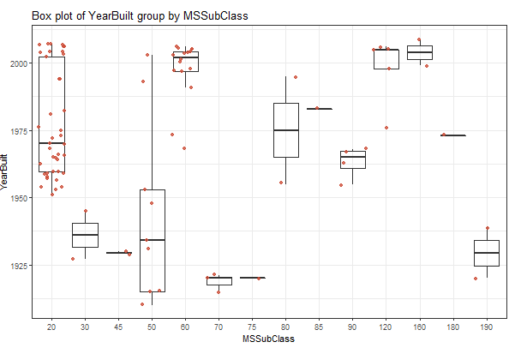
Visualization with Shiny
2 Dimensional Distribution Graph with 1 Cate Var 1 Number Var

Slide 25
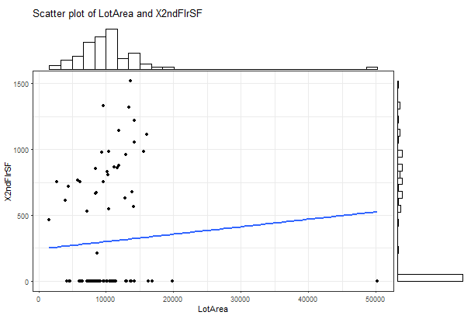
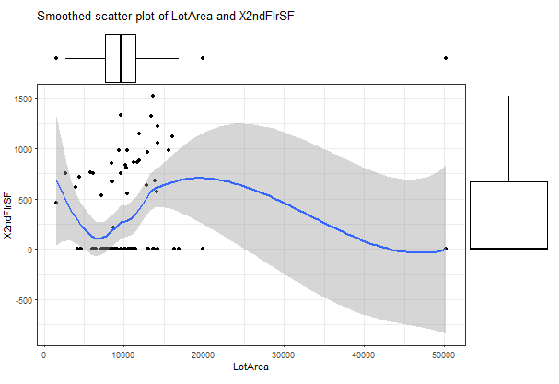
Visualization with Shiny
2 Dimensional Distribution Graph with 2 Real Number Variable

Slide 26
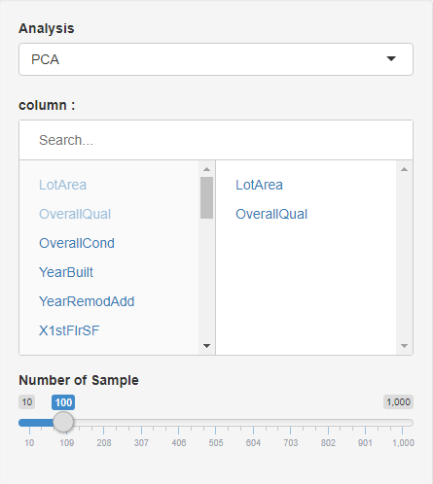
Visualization with Shiny
Analysis Panel Setting:
Analysis Type: PCA or CA
Target Column: specify the column to be analysed
Number of Sample: specify analysed sample number

Slide 27
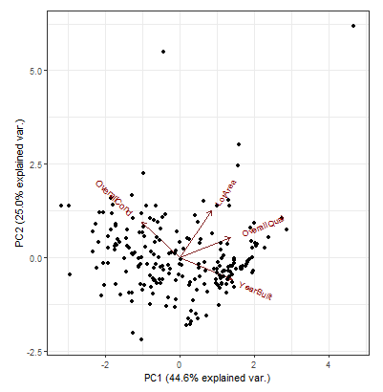
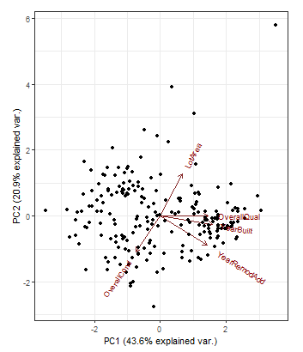
Visualization with Shiny
Visualize Analysis Result by Different Target Column Set

Slide 28
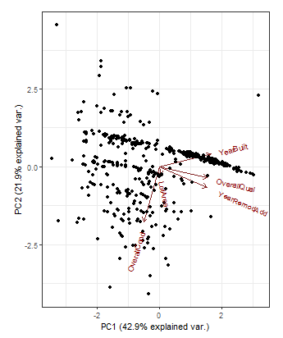
Visualization with Shiny
Visualize Analysis Result by Different Sample Point

Slide 29
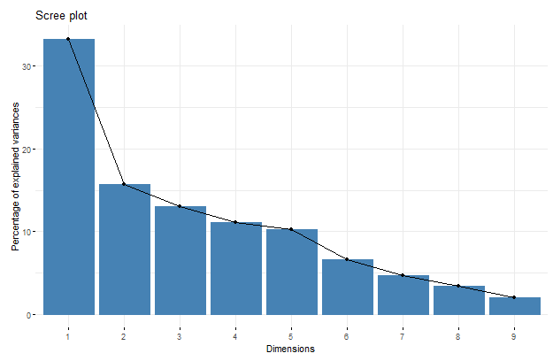
Visualization with Shiny
Principal Component Analysis(PCA)

Slide 30
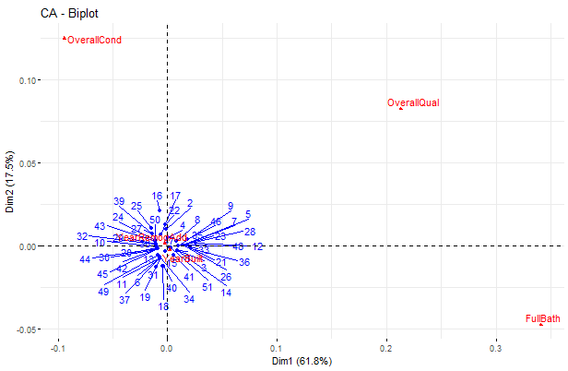
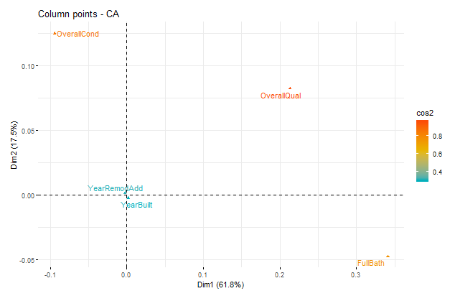
Visualization with Shiny
Correspondence Analysis(CA)

Slide 31
Modeling

Slide 32
Feature Enginering
Add new variables:
Old <- YrSold - YearBuilt
OverallGrd <- OverallQual * OverallCond
GarageScore <- GarageArea * GarageQual
Delete variables

Slide 33
Model Evaluation & Comparison
此為Kaggle競賽資料，所以原本就有測試資料集被切出，因此我們的訓練資料(即前1460筆資料)僅切割成訓練集和驗證集，採用的方式為10-fold，另外，為了公平比較模型，四個模型的訓練集與驗證集皆相同。
房價為連續型資料，所以我們針對四個模型分別計算訓練集與驗證集的RMSE與RMSLE，並且將Kaggle所給的測試資料預測後上傳，看測試資料的RMSLE，之後針對三個資料集的四個模型預測結果進行比較。

Slide 34
Null Model:
Decision Tree

Slide 35
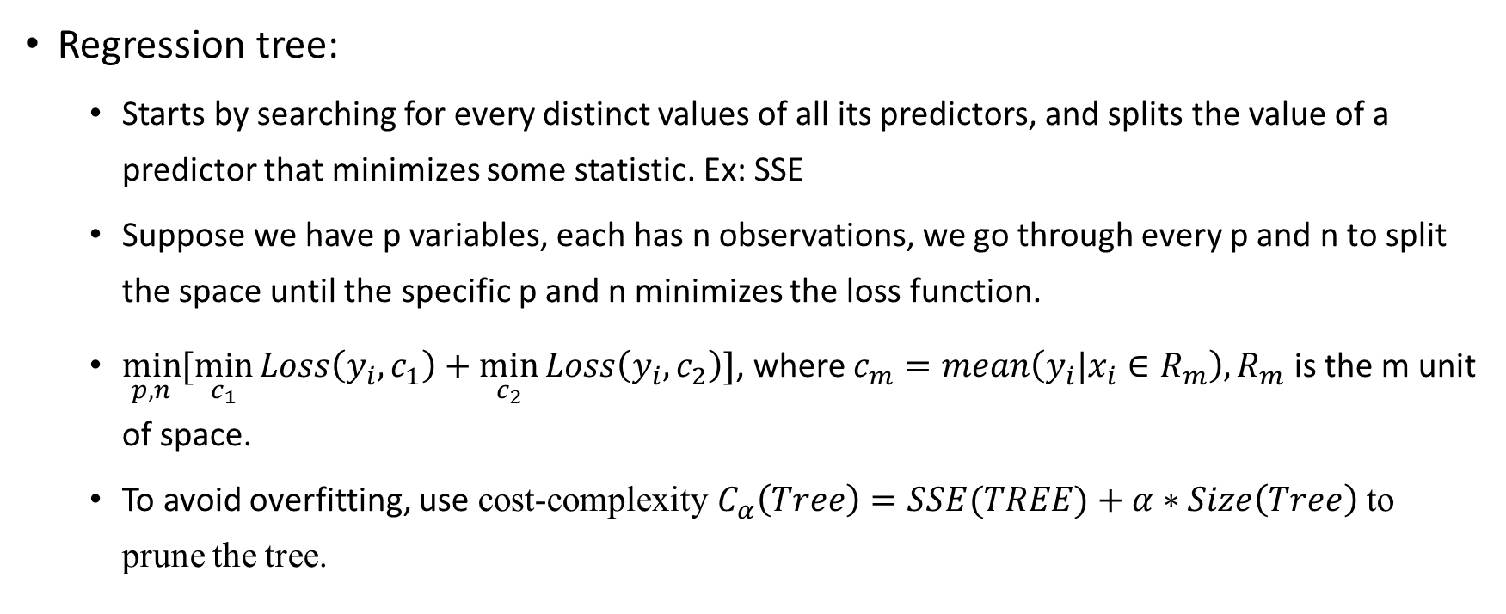
Modeling – Decision tree

Slide 36
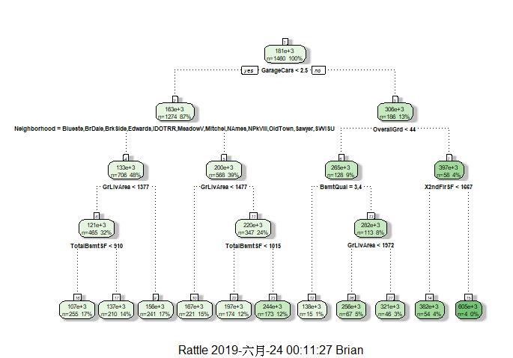
Tree

Slide 37
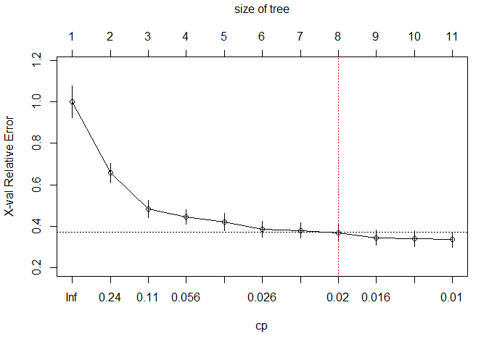
CP

Slide 38
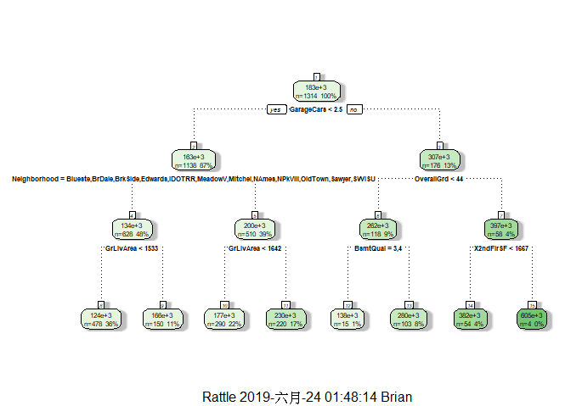
Prune tree

Slide 39
Result
 | RMSE | RMSLE
Train | 42103.03 | 0.32294
Validation | 48190.42 | 0.50644
Test |  | 0.26675

Slide 40
Random Forest

Slide 41
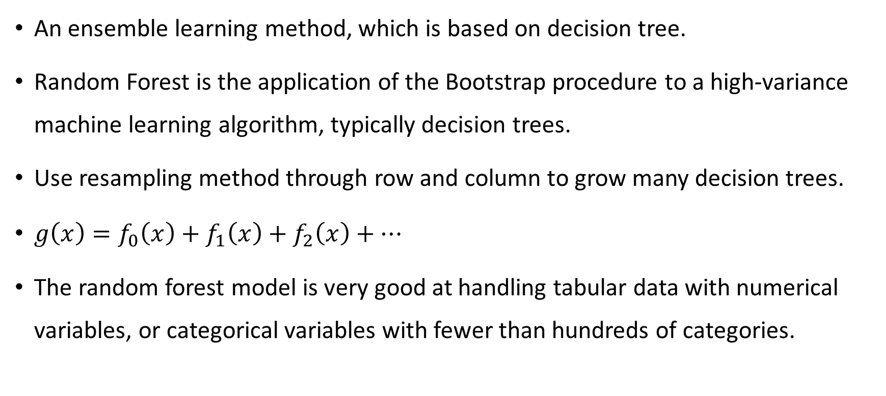
Modeling – Random Forest

Slide 42
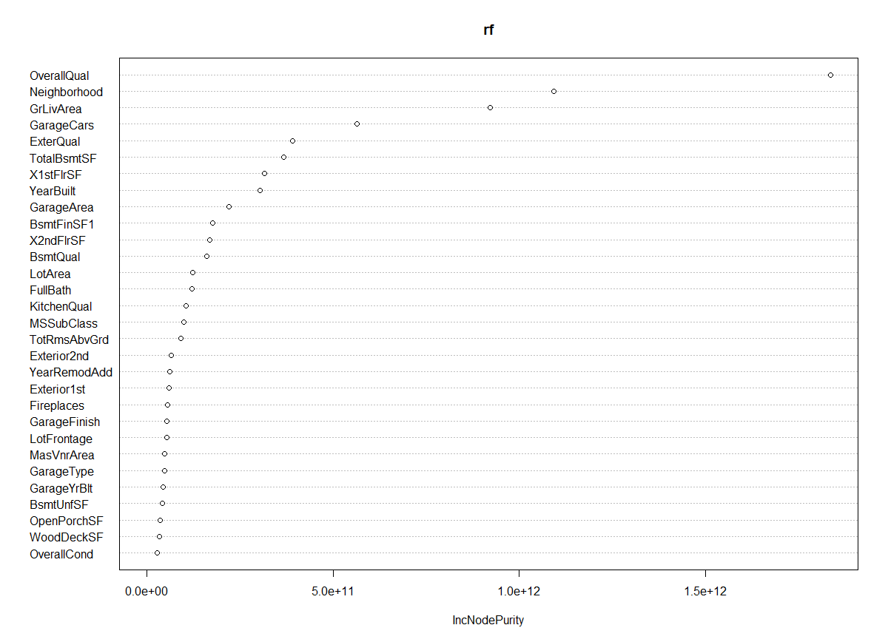
Importance
The total decrease in node impurities from splitting on the variable, averaged over all trees. For regression, it is measured by residual sum of squares.

Slide 43
Result
 | RMSE | RMSLE
Train | 27830.70 | 0.14063
Validation | 27577.55 | 0.13999
Test |  | 0.14814

Slide 44
XGBoost

Slide 45
Modeling – XGBoost
Boosted tree 為基於cart樹的一種ensemble方法。
基本概念是將每次cart樹的預測分數f累加得到我們要的預測結果，
每一輪都選取能使目標函數下降最多的cart樹的結果加入前一輪的結果。
Cart樹對資料點的預測分數，取決於資料點被劃到哪個葉子上，而該葉子會加減多少分稱之為權重w。
資料點如何分到特定葉子則稱為q(樹的結構)
定義複雜度函數Ω為W與T(葉子個數)的函數

Slide 46
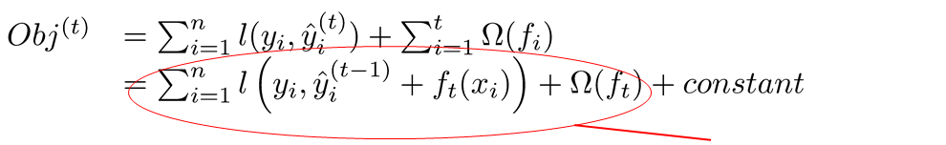
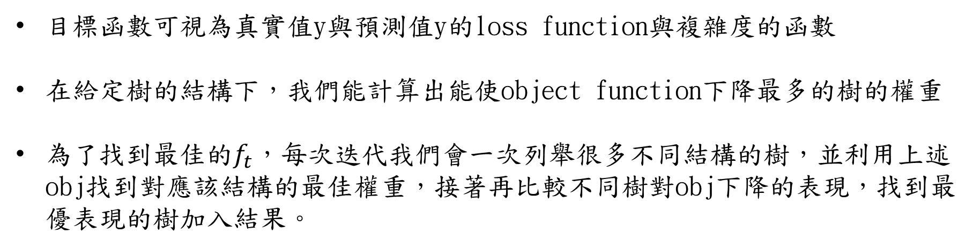

Modeling – XGBoost
想找到最佳的$f_{t}$
目標函數可視為真實值y與預測值y的loss function與複雜度的函數
在給定樹的結構下，我們能計算出能使object function下降最多的樹的權重
為了找到最佳的$f_{t}$，每次迭代我們會一次列舉很多不同結構的樹，並利用上述obj找到對應該結構的最佳權重，接著再比較不同樹對obj下降的表現，找到最優表現的樹加入結果。

Slide 47
Modeling – XGBoost
每次迭代列舉的樹都是把之前已分割的節點繼續切下去，由於有複雜度懲罰項的關係，一直切下去不一定會比較好，若是下降幅度太小會減掉這次樹的分枝。
XGBoost是在目標函數中的模型複雜度中，使用L2的正規化項(權重w的平方和乘上給定的lambda)，並導入學習速率eta，讓我們能自己調整每次迭代影響的大小。

Slide 48
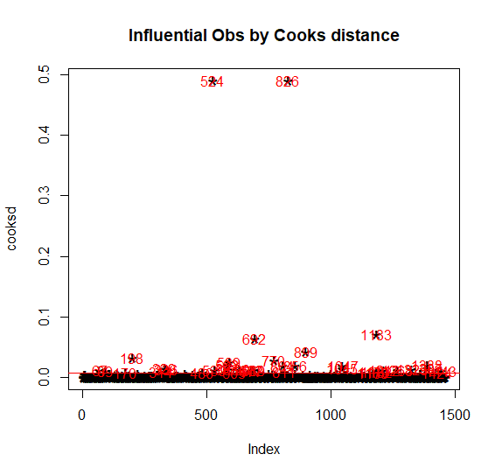
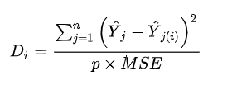
Handling Outliers
首先先建立多元迴歸模型，並利用cook distance，幫助我們找到離群值，定義cooksd>4倍mean(cooksd)者為離群值，移出訓練集。

Slide 49
Choosing parameters
對於模型參數
nrounds = 總迭代次數
max_depth = 單一CART樹最大深度
eta = 學習率
subsample = 生成每棵樹使用的樣本比率
我們使用caret套件幫助我們對參數進行grid search ，經過嘗試後，使用
nrounds=100
eta = 0.075,
max_depth = 8,
subsample = 0.5
而L2正規項係數的lambda經過嘗試後決定使用3

Slide 50
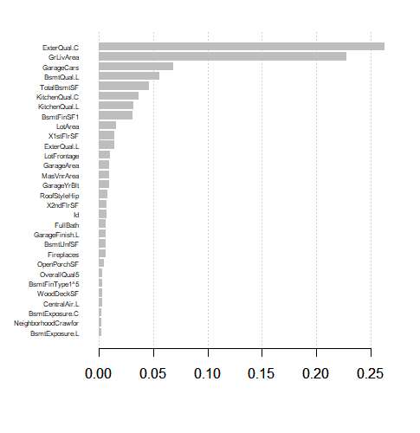
Feature importance
變數重要性如下，其中x軸為gain，為目標函數下降的貢獻比例(由每次迭代的樹加總)，這裡僅列出前30重要的特徵。

Slide 51
Result
 | RMSE | RMSLE
Train | 9709.454 | 0.05482
Validation | 26980.14 | 0.13752
Test |  | 0.13882

Slide 52
Support Vector Regression

Slide 53
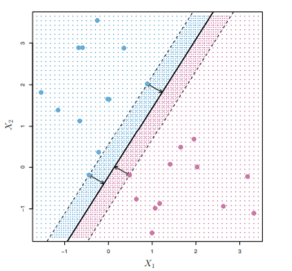
Introduction
hyperplane
The basic idea of SVM：
Find a hyperplane to separate different categories and maximize margin
margin
Figure 9.3 An Introduction to Statistical Learning by Gareth James Daniela Witten Trevor Hastie Robert Tibshirani

Slide 54
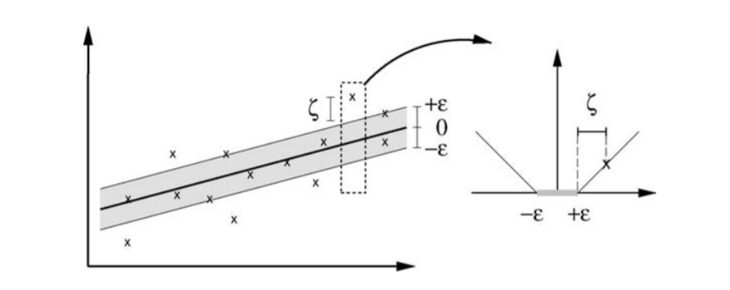
Introduction
The basic idea of support vector regression:
Find a hyperplane to predict y and minimize the ε-insensitive loss
Figure 1 A tutorial on support vector regression, ALEX J. SMOLA and BERNHARD SCHOLKOPF, Statistics and Computing 14: 199–222, 2004

Slide 55
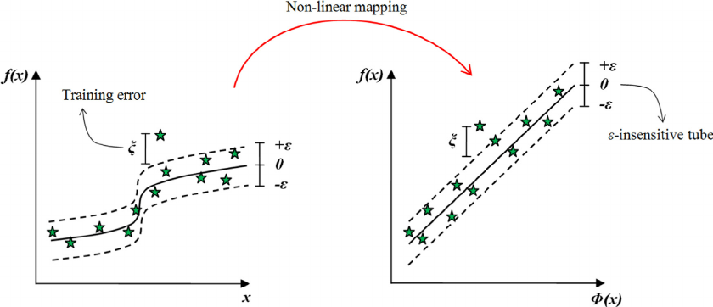
Introduction
The purpose of kernel:
Figure 1 A support vector regression model for predicting tunnel boring machine penetration rates by Satar Mahdevaria,n, Kourosh Shahriara, Saffet Yagizb, Mohsen Akbarpour Shirazi, International Journal of Rock Mechanics & Mining Sciences 72 (2014) 214–229

Slide 56
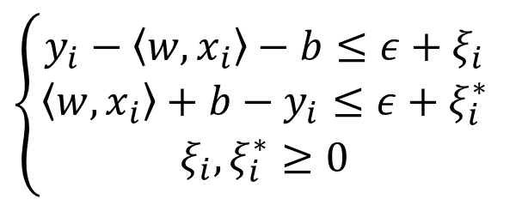
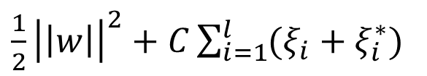
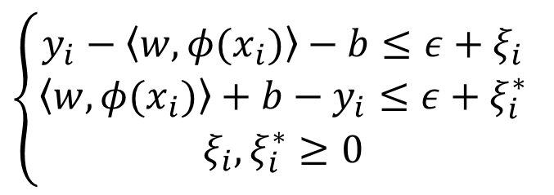
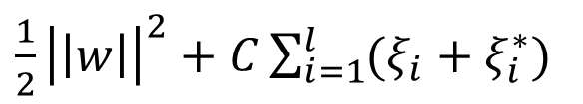
Introduction
差異在是否對自變數做非線性轉換
The equations of SVR need to solve:
$\frac{1}{2}{\left|\left|w\right|\right|}^{2}+C\sum_{i=1}^{l}{(ξ_{i}+ξ_{i}^{∗})}$
$\frac{1}{2}{\left|\left|w\right|\right|}^{2}+C\sum_{i=1}^{l}{(ξ_{i}+ξ_{i}^{∗})}$
minimize
minimize
$\left\{\begin{aligned}y_{i}−\left\langle w,x_{i}\right\rangle −b≤ε+ξ_{i} \\ \left\langle w,x_{i}\right\rangle +b−y_{i}≤ε+ξ_{i}^{∗} \\ ξ_{i},ξ_{i}^{∗}≥0\end{aligned}\right.$
$\left\{\begin{aligned}y_{i}−\left\langle w,φ(x_{i})\right\rangle −b≤ε+ξ_{i} \\ \left\langle w,φ(x_{i})\right\rangle +b−y_{i}≤ε+ξ_{i}^{∗} \\ ξ_{i},ξ_{i}^{∗}≥0\end{aligned}\right.$
subject to
subject to
Linear
Nonlinear

Slide 57
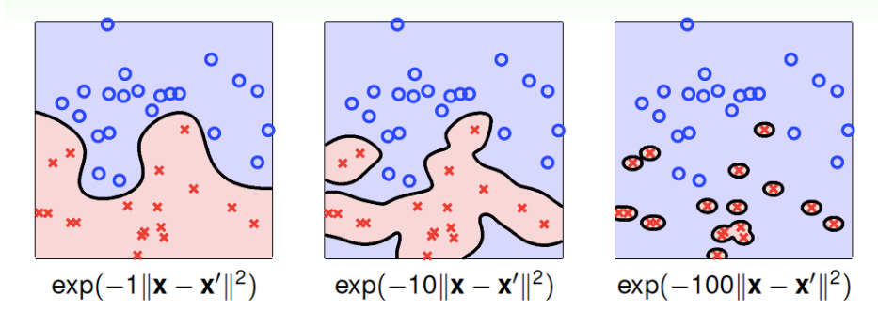
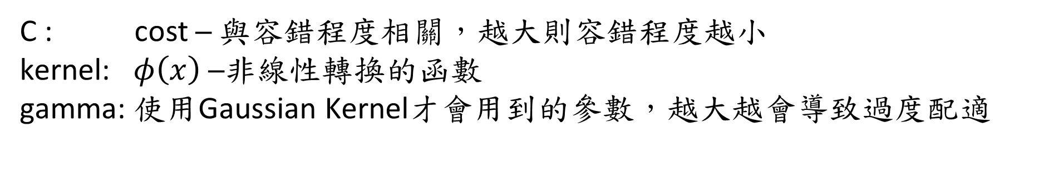
R Package Tune Parameter
使用的套件：e1071
可調參數對照：
C : cost ─ 與容錯程度相關，越大則容錯程度越小
kernel: $φ\left(x\right)$ ─非線性轉換的函數
gamma: 使用Gaussian Kernel才會用到的參數，越大越會導致過度配適
gamma分別為1,10,100下的SVM配適情況，擷取自林軒田教授機器學習技法

Slide 58
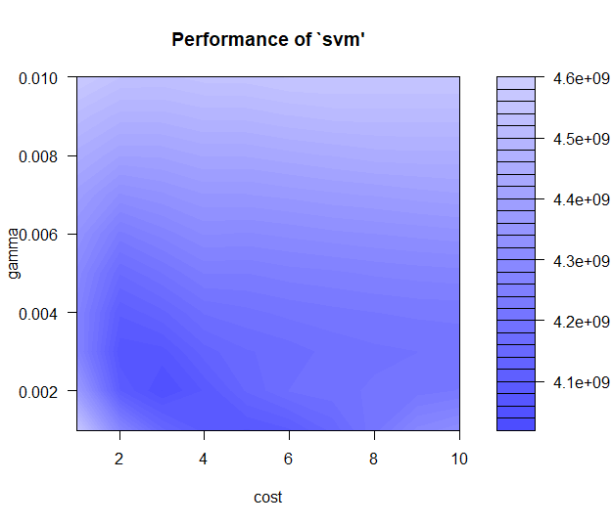
Tune Result
cost : 3.4
gamma : 0.002

Slide 59
Model Evaluation
 | RMSE | RMSLE
Train | 22990.07 | 0.10166
Validation | 27321.55 | 0.12306
Test |  | 0.11798

Slide 60
Comparison Result
RMSE of Four Model
 | Decision Tree | Random Forest | XGBoost | SVR
Train | 42103.03 | 27830.70 | 9709.454 | 22990.07
Validation | 48190.42 | 27577.55 | 26980.14 | 27321.55

Slide 61
Comparison Result
RMSLE of Four Model
 | Decision Tree | Random Forest | XGBoost | SVR
Train | 0.32294 | 0.14063 | 0.05482 | 0.10166
Validation | 0.50644 | 0.13999 | 0.13752 | 0.12306
Test | 0.26675 | 0.14814 | 0.13882 | 0.11798

Slide 62
Reference
Packages:
ggplot2
ggpubr
rpart
rpart.plot
rattle
randomForest
e1071
xgboost

Slide 63
Reference
https://www.kaggle.com/c/house-prices-advanced-regression-techniques/overview
https://www.kaggle.com/erikbruin/house-prices-lasso-xgboost-and-a-detailed-eda
https://zhuanlan.zhihu.com/p/51586879
https://zhuanlan.zhihu.com/p/49049535
https://cloud.tencent.com/developer/article/1005033
https://github.com/topepo/caret/issues/336
https://zhuanlan.zhihu.com/p/24577989 https://stackoverflow.com/questions/39371738/r-xgboost-importance-plot-with-many-features
http://steve-chen.tw/?p=369
http://www.dehong.space/XGBoost
https://www.rdocumentation.org/packages/xgboost/versions/0.6.4.1/topics/xgb.importance
A tutorial on support vector regression, ALEX J. SMOLA and BERNHARD SCHOLKOPF, Statistics and Computing 14: 199–222, 2004
A support vector regression model for predicting tunnel boring machine penetration rates, Satar Mahdevari, Kourosh Shahriar, Saffet Yagiz and Mohsen Akbarpour Shirazi, International Journal of Rock Mechanics & Mining Sciences 72 (2014) 214–229
An Introduction to Statistical Learning, Gareth James Daniela Witten Trevor Hastie Robert Tibshirani
Support Vector Machine Regression, http://kernelsvm.tripod.com/,2019/06/24
林軒田教授機器學習技法，https://www.csie.ntu.edu.tw/~htlin/mooc/

